Slide 1
PoinTr Detailed Review

Slide 2
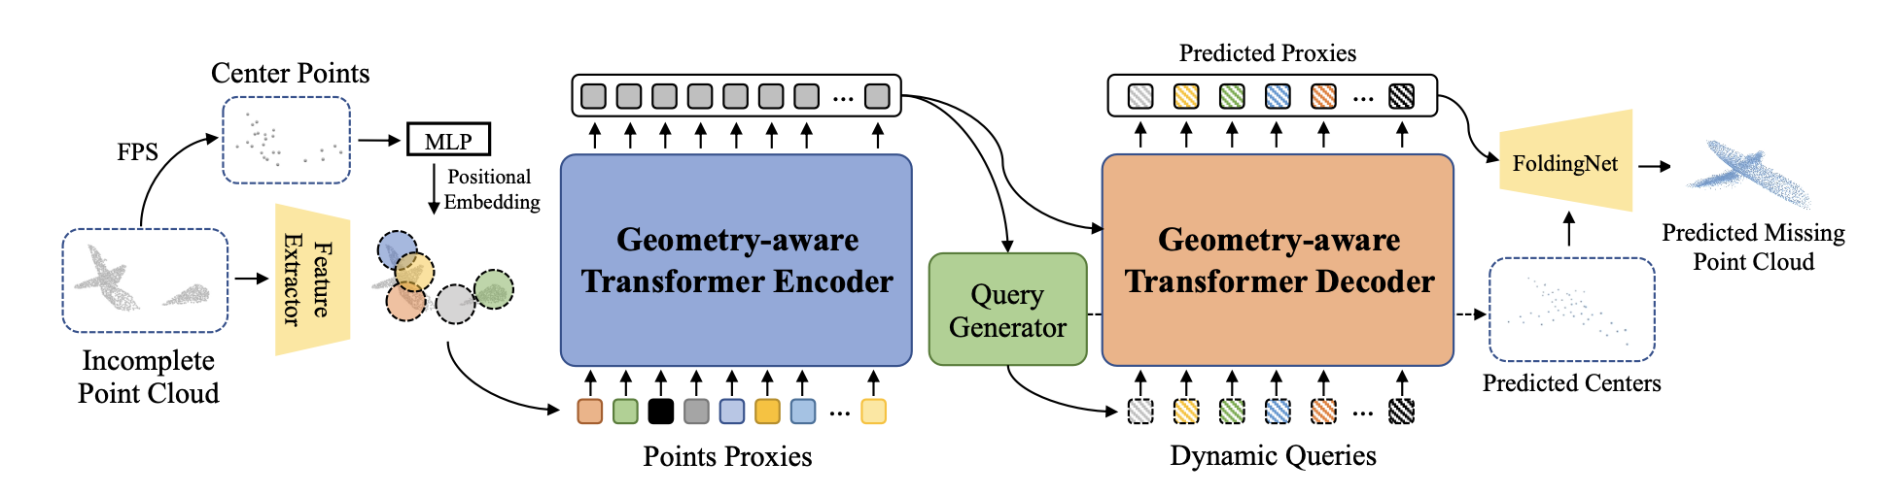
PoinTr Pipeline
relationships between
proxies
forming point proxies
i.e. token sequence, relationships inside local patches

Slide 3
Step 1: Forming Point Proxies
FPS, kNN, DGCNN, MLP

Slide 4
FPS (Farthest Point Sampling)
incomplete point cloud → FPS → center points → DGCNN → extracted features
FPS is a widely used method for the point cloud case as it reduces the number of points while still preserving the overall geometric coverage of the shape.
(eg. PointNet)
“locate a fixed number N of point centers {q1, q2, ..., qN } in the partial point
cloud”
Then, local neighbourhoods are defined based on these center points, via kNN.
Each group becomes a local point patch.

Slide 5
DGCNN(Dynamic Graph Convolutional Neural Network)
incomplete point cloud → FPS → center points → DGCNN → extracted features
hierarchical downsampling, feature extraction
Main idea is to build a local kNN graph and learn edge features between neighboring points using EdgeConv.
DGCNN plays a role similar to PointNet, i.e. summarizes small patches into single feature vectors.

Slide 6

Point Proxy
point proxy
feature of point
point
MLP
Feature extraction module (FPS, kNN, DGCNN…) extract semantic patterns(geometry-aware features) of local patches.
MLP captures the location information of the point proxy, inspired by the position embeddings.
Binding them together, we get feature vectors including both semantic and locational knowledge per every center point qi, which paper names as ‘point proxies’.

Slide 7
Step 2: Geometry-Aware Transformer Encoder

Slide 8
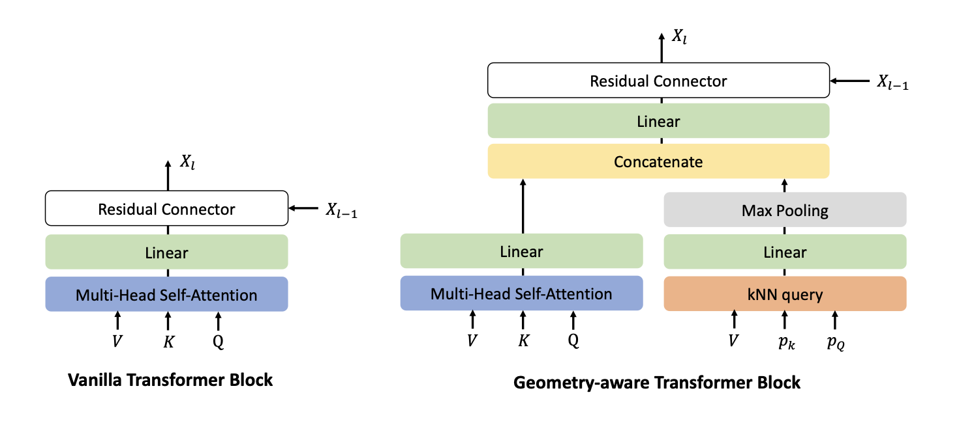
Goal: inductive bias
following the practice of
DGCNNs
capture geometric relation

Slide 9
Revisiting “Attention is All You Need(2017)”

Slide 10
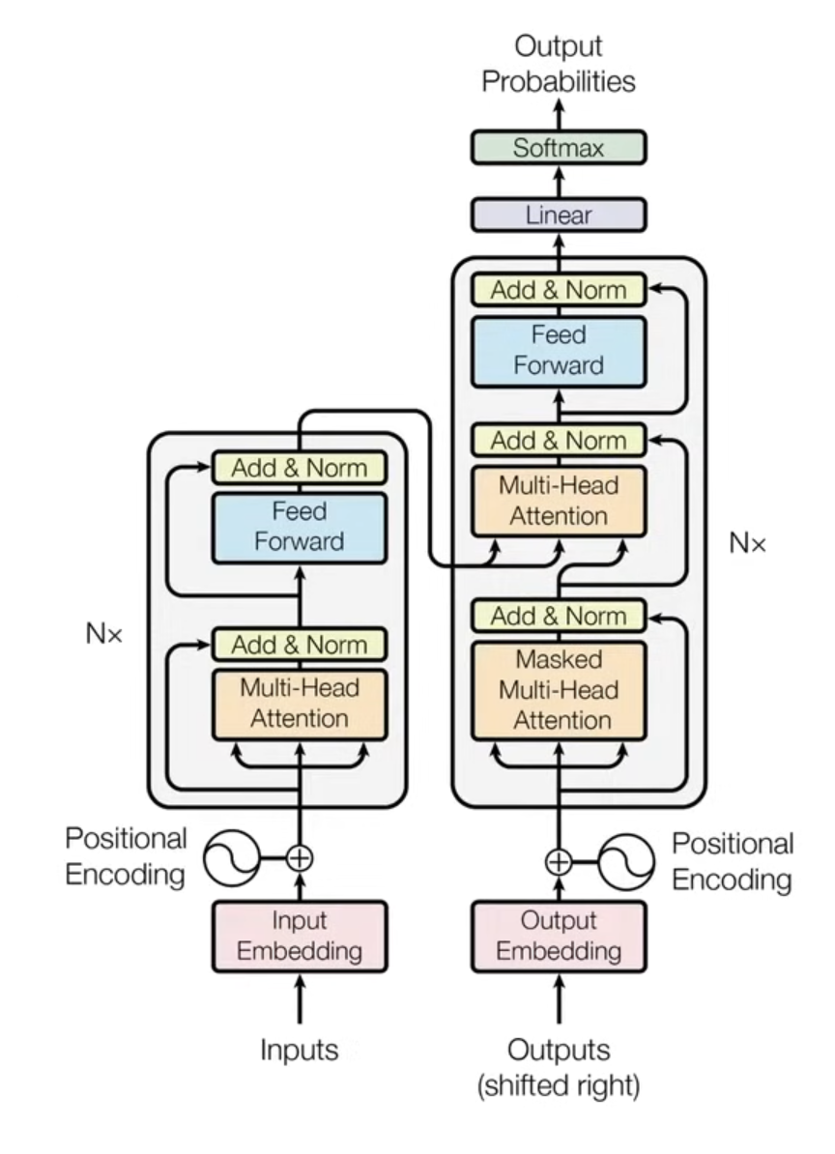
Transformer Architecture
linear layer
only compute once, then reuse for every sentence
encoder input
encoder
decoder

Slide 11
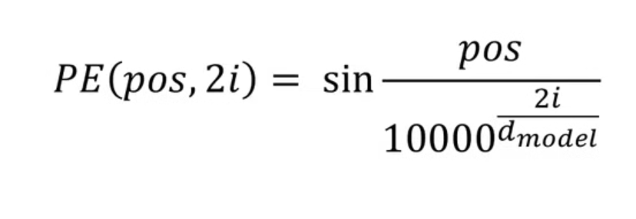
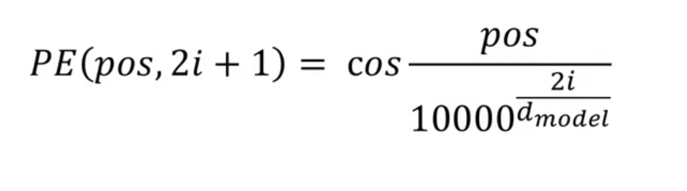
Positional Encoding
each word should carry information about its position in the sentence
Why trigonometric functions?
For every position to have a different signature pattern.
absolute position + relative position (as it can be inferred by the formula.)
sinusoidal positional encodings are STATIC!

Slide 12
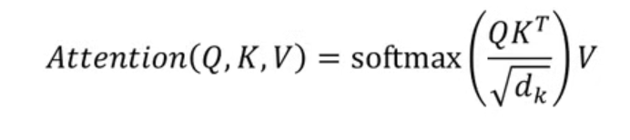
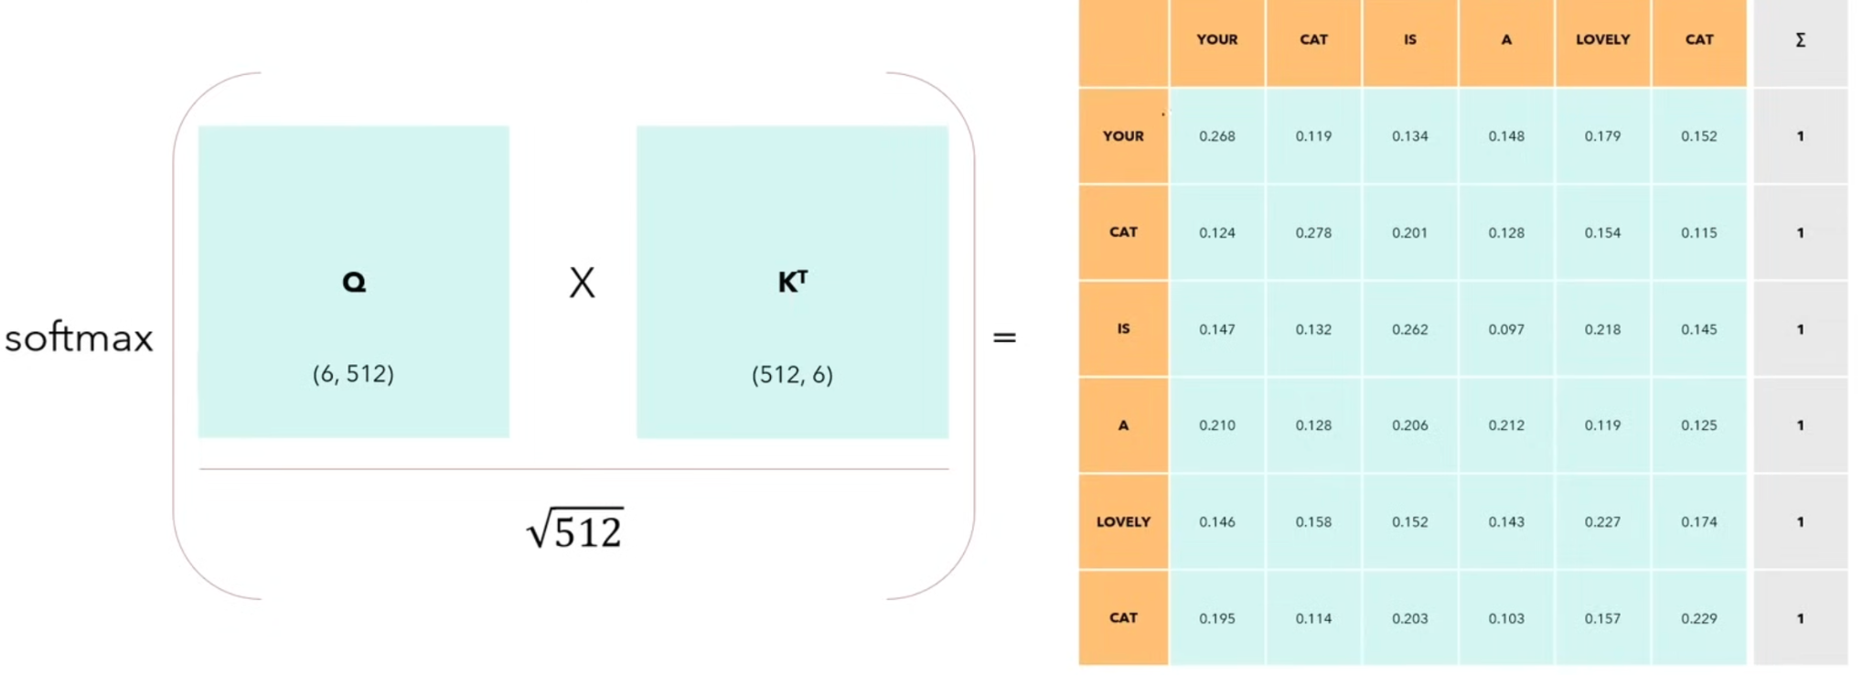
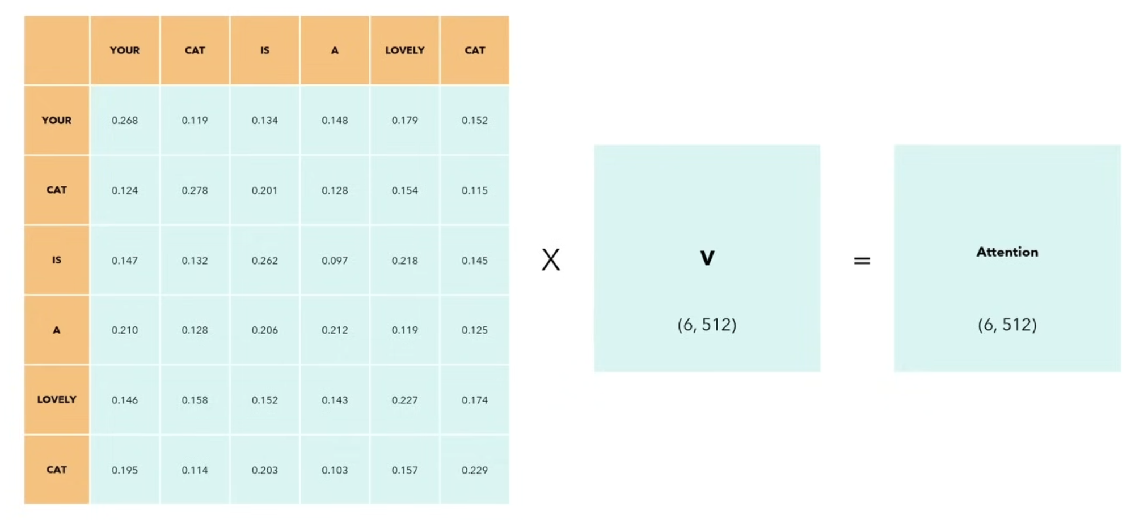
Self-attention
permutation invariant, no parameters except embeddings
allows model to relate words to each other (self → same sentence)
Q = query
K = key
V = value
i.e. input sentence
Now, each row contains not only
meaning or position but also
each word’s interaction with others

Slide 13
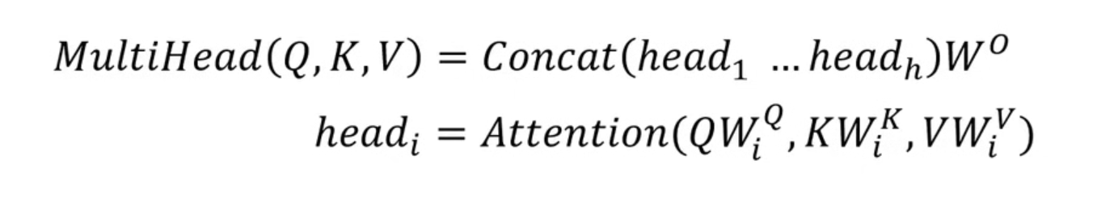
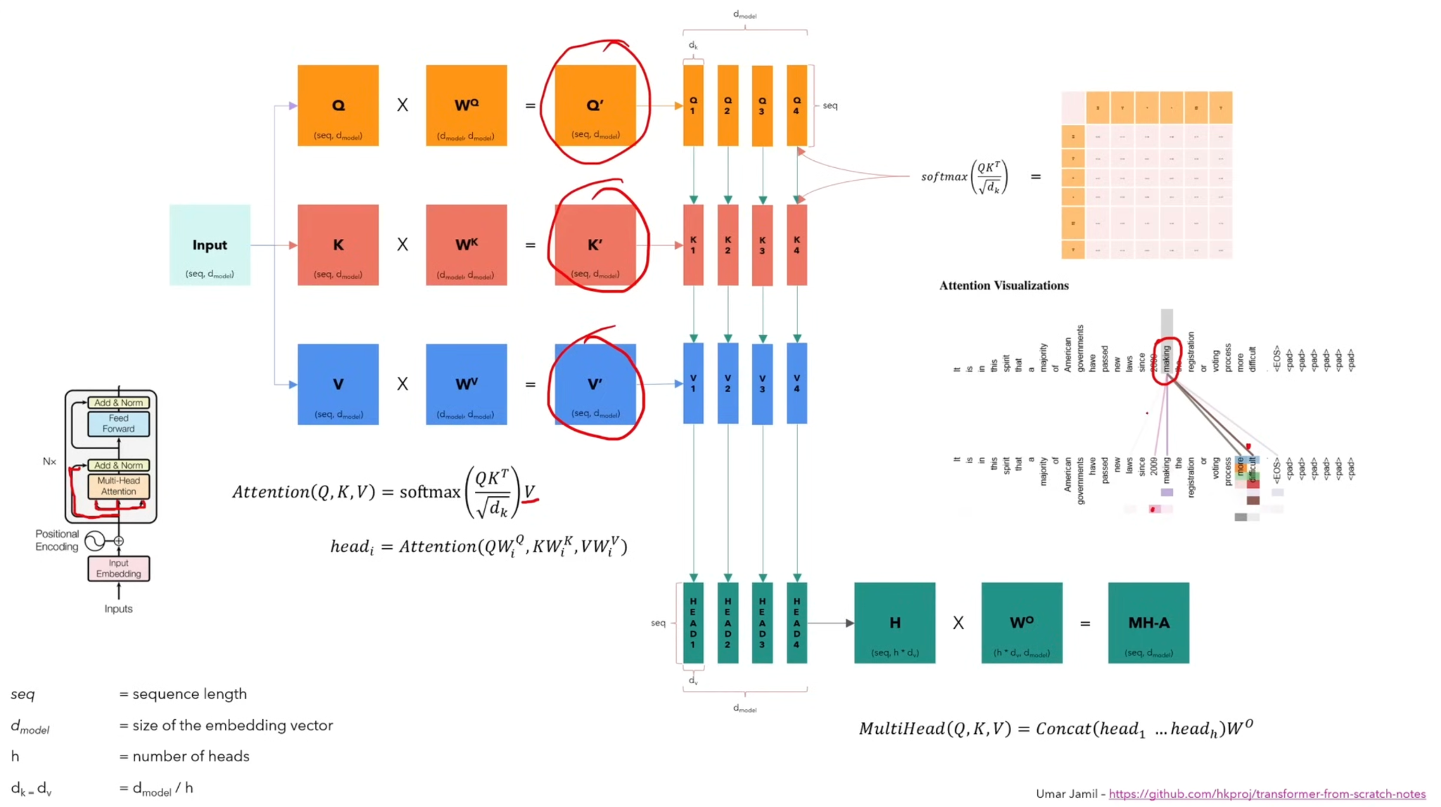
Multi-head Attention
every head will see the full sentence but a smaller part of embedding of each word

Slide 14
Masked Multi-Head Attention
model must not be able to see future words, for it to be causal.
all values above the principal diagonal will be changed with -∞ before softmax, thus they will not be considered.

Slide 15
Training and Inference of a Transformer Model
prepend and append special tokens to the sentence to represent start and end.
<SOS> <EOS>
calculate cross entropy loss between output probabilities and target

Slide 16
Step 3: Query Generator

Slide 17
Problem: no output tokens like the NLP case
generate the query embeddings dynamically conditioned on the encoder output
V = updated visible point proxy features → linear projection → max pooling
summarized into a global feature. (similar to PCN)
global feature → linear projection → M 3D coordinates
concatenate global feature and coordinates per every coordinate → query seed
MLP converts this set into query embedding format and updates as Q.

Slide 18
Step 4: Geometry-Aware Transformer Decoder

Slide 19
Decoder Arcihtecture
updating Q guided by V
self-attention over Q(consistent predicted missing proxy features)
cross-attention from Q to V (Q collects information from every visible point proxy)
forming missing proxy features
generating output in the proxy feature space, at first, dynamic queries were unaware of the visual context

Slide 20
Step 5: Multi-scale Point Cloud Generation
Proposal: generative refinement

Slide 21
Revisiting “FoldingNet(2017)”

Slide 22
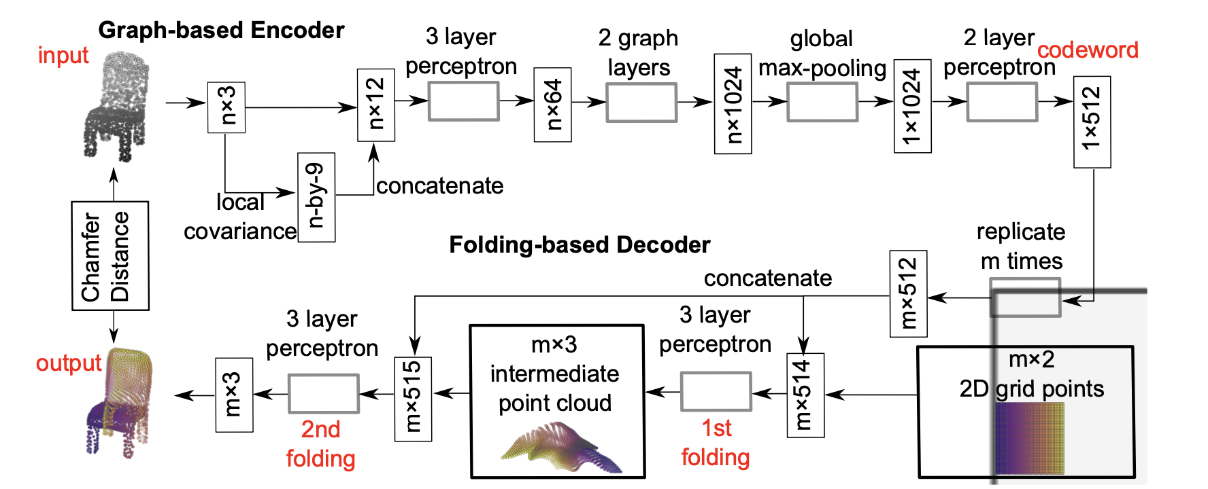
FoldingNet Pipeline
Note: FoldingNet is an autoencoder architecture. (i.e. encoder → latent vector → decoder)

Slide 23
Graph-based Encoder
concatenation of MLPs and graph-based max pooling layers
K-NNG = capture local geometry (needed to calculate covariance matrix)
calculating local covariance matrix per every point, vectorize, concatenate with coordinates
shared MLP per every row
2 graph-based max pooling layers
forming global representation

Slide 24
Folding-based Decoder
form 2D grid
repeat codeword generation per every grid point, concatenate with grid points
folding = applying same 3-layer MLP to every point
1st folding: 2D grid → coarse 3D surface
concatenate output with codeword
2nd folding: refinement of 3D surface
i.e. codeword guides how to fold into 3D surface (2D grid + codeword → folded 3D surface)

Slide 25
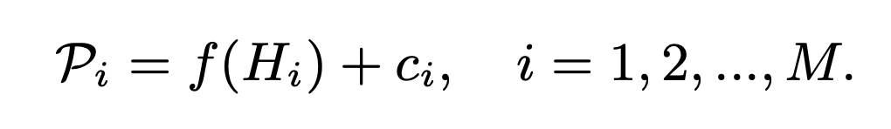
Utilizing FoldingNet
missing proxy features
FoldingNet decoder
center coordinates generated by query generator
FoldingNet converts missing proxy features(output of the decoder), into 3D points
forming a patch per every proxy
concatenate every patch and form missing point cloud estimate
concatenate estimate with the incomplete input

Slide 26
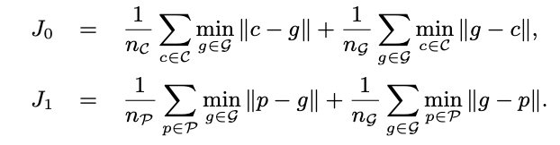
Step 6: Optimization
Chamfer Distance

Slide 27
AdaPoinTr Detailed Review
PoinTr + adaptive query generation + denoising task / denoising queries

Slide 28
Problem with PoinTr
Input point cloud and predicted missing point cloud actually come from different sources.(i.e. final point cloud emerges from concatenation)
Motivation: processing known and missing parts together at an earlier stage(at the proxy/query level). (i.e. final point cloud emerges from a single, unified reconstruction process)
known part proxies + missing part proxies → shared reconstruction model → complete point cloud
Method:
adaptive query generation
auxiliary denoising task

Slide 29
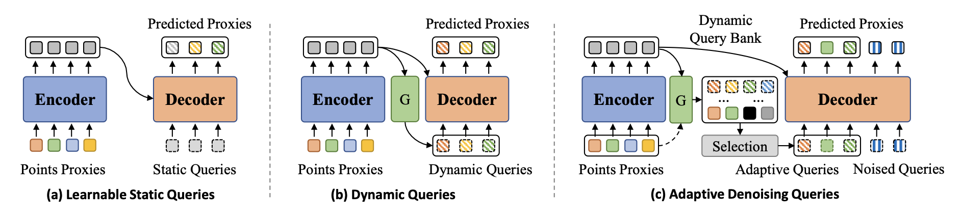
Adaptive Denoising Queries
!!!

Slide 30
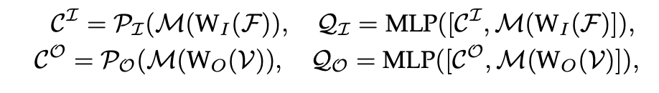
Adaptive Query Generation
coordinate projection
linear projection
maxpool
query coordinate candidates
MLP to convert into embeddings
B = QI + QO
B = dynamic query bank
QI = queries generated from input point proxies F (queries representing the visible part)
QO = queries generated from encoder output V (queries as the starting point hypotheses for the missing parts)
scoring module
query embedding → MLP/Linear → scalar score

Slide 31

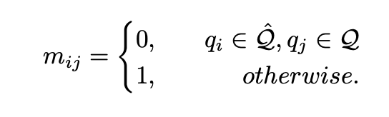

Auxiliary Denoising Task
noisy centers
noised query generation:
guarantees there are high-quality queries fed into decoder
improves the robustness of the decoder to initial queries
attention mask for noised queries:
to prevent leakage
translation into predicted proxies:
(decoder)

Slide 32
Experiment Proposals

Slide 33
Generative Query Generator
AdaPoinTr deterministically generate decoder queries.
model AdaPoinTr’s query space as a conditional generative distribution?
i.e.
partial point cloud + z → adaptive queries → completion 1
partial point cloud + z₂ → adaptive queries → completion 2
partial point cloud + z₃ → adaptive queries → completion 3

Slide 34
Diffusion over decoder output
making proxy representation generative
Proxy-space diffusion
i.e.
H_t = noisy missing proxy features
condition = encoder output V, queries Q, maybe centers C
Denoiser(H_t, V, Q, t)

Slide 35
FoldingNet + generative refinement
utilizing PoinTr output as a starting point for the diffusion model
(PoinTr as the guide)
denoiser(x_t, condition, t)
condition = partial point cloud + PoinTr coarse completion

Slide 36
Research in the Completion-Diffusion Direction
PDR(2022)
PVD(2021)

Slide 37
PDR Review

Slide 38
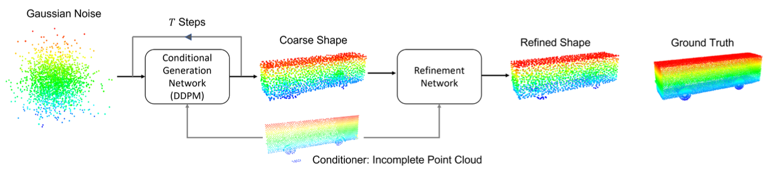
PDR Pipeline

Slide 39
PVD Review

Slide 40
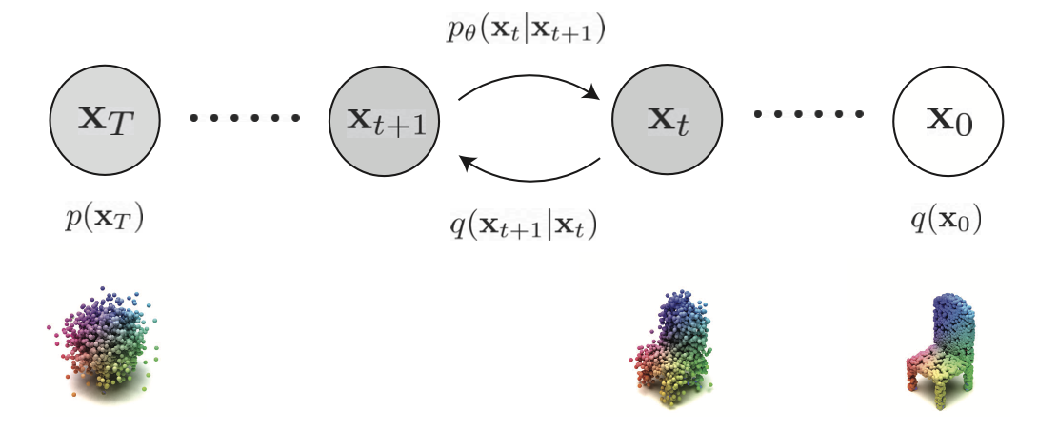
PVD Flow

